Slide 1
HDD and SSD

Slide 2
What is the basic unit of storage for an HDD?
Track
Byte Cell
Sector
Platter

Slide 3
What is the total number of tracks available in an HDD with 4 heads, 2 platters and 1024 cylinders?
1024
2048
4096
8192
HDD storage medium consists of one or more ‘Platters’, and each platter has two surfaces. Each surface is served by a Read/Write Head.
‘Cylinders are formed by connecting imaginery lines between same-number tracks from different surfaces. E.g. connecting track number 200 in all surfaces.
With 1024 cylinders, it implies there are 1024 tracks on each surface. Since there are 2 platters, it means there are total of 4 surfaces in this HDD.
4*1024 = 4096.

Slide 4
What does 1/RPS represent?
Time taken (in seconds) to rotate the platter one round
Time taken (in minutes) to rotate the platter one round
Rotational Frequency in rev/seconds
Rotational Frequency in rev/minutes
RPS = Revolution Per Second
1/RPS = time taken for platter to rotate one round.

Slide 5
What does N/(Dt*Ds) represent?
Track Density D_{T} (number of sectors per track)
Sector Density D_{S} (number of bytes per sector)
number of bytes N for the transfer.
Ratio of number of bytes read to total bytes in the HDD
Ratio of number of bytes read to total bytes in the cylinder
Ratio of time it takes to transverse the sectors to read to time it takes to spin the disc one round
Ratio of time it takes to spin the disc for N revolutions.
Dt*Ds = total number of bytes in one track.
=> Time required to transverse over the length of the sectors to be read is proportional to the number of bytes to be read => [C].

Slide 6
Why does it take longer to read N random sectors compared to N consecutive sectors?
More difficult to compute the locations of each sector
Buffering can be done for sequential access
Access to each new sector incur an additional access time
None of the above
After reading one sector, the actuator ARM has to re-position itself to the start of the next sector.
If the next sector is in a different track, then the actuator ARM will require time to move to the correct track and rotate to the correct sector in order to position the Read/Write Head at the correct starting sector, essentially equal to the Access Time (Seek Time + Rotational Delay).

Slide 7
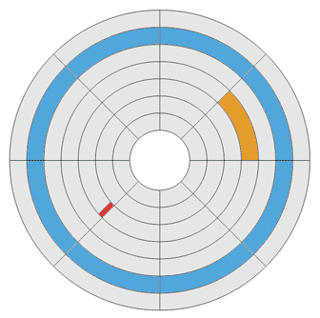
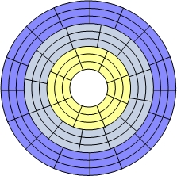
**Which of the following is/are true for Zone Bit Recording?
Zone Bit Recording involves partitioning the HDD media to different zones and allocate different number of sectors/track for each zone.
This fully utilises the HDD media as the length of media used to store one sector of data will be more or less the same throughout the entire media.
More complex than constant sectors/track layout
Better utilisation of recording media
Simpler than constant sectors/track layout
Different number of sectors per track for different zone

Slide 8
What is wear leveling?
Levelling the physical wear and tear of flash memories
Spreading erase operations evenly throughout each location in the flash
Decrease the total number of erasure operations
Increase the total number of erasure operations

Slide 9
**What advantage(s) does SSD has over HDD?
Lighter
Lower cost per bit
Higher transfer rate
Less moving parts

Slide 10
**What advantage(s) does HDD has over SSD?
Lighter
Lower cost per bit
Higher transfer rate
Infinite erase cycles

Slide 11
**Which of the following are criteria of concern when selecting storage elements for a Data Center?
Reliability of storage element
Access time of storage element
Power consumption of storage element
Availability of cooling elements

Slide 12
What is the purpose of the laser in a HAMR HDD?
Illuminate the recording area
Direct the Read/Write Head to the correct recording area
Heat up the recording area to lower the media’s coercivity
Heat up the recording area to improve platter rotation speed

